Slide 1

Video Game Sales-Nintendo
Competitive Landscape Analysis w/ R
Team member names: Joshua McCleary, Jennifer Rogers, James Watson, Nicholas McIntosh Team’s Organization: United Gamers Associations Date of in-class presentation: 6/9/2020

Slide 2

Inspiration
We are a group of avid gamers who have grown up with a lot of fond memories of different game titles, epic storylines, and unforgettable characters. Due to our experience with this medium we thought it would be interesting to dive into the statistics of video games and use our findings to make recommendations on how to continue making great games in the year 2020 and beyond.

Slide 3
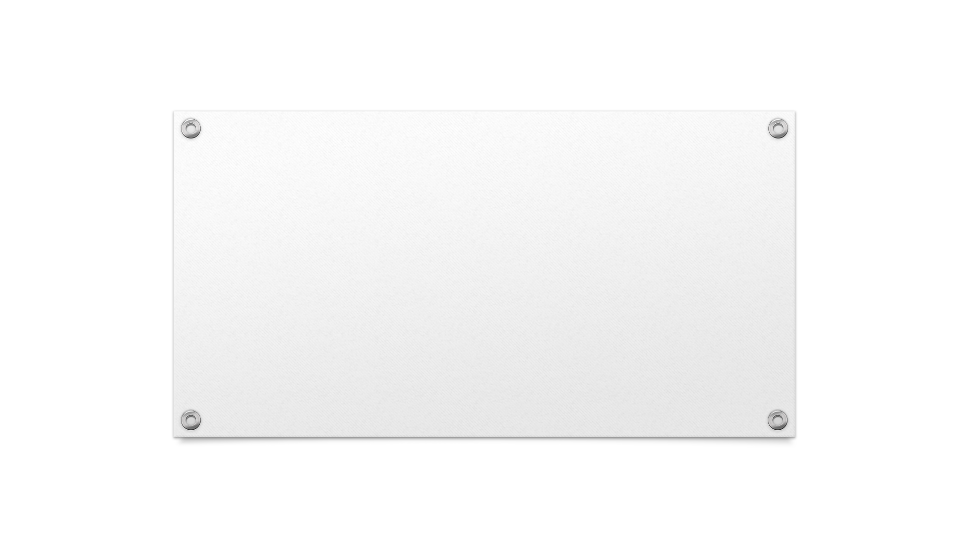
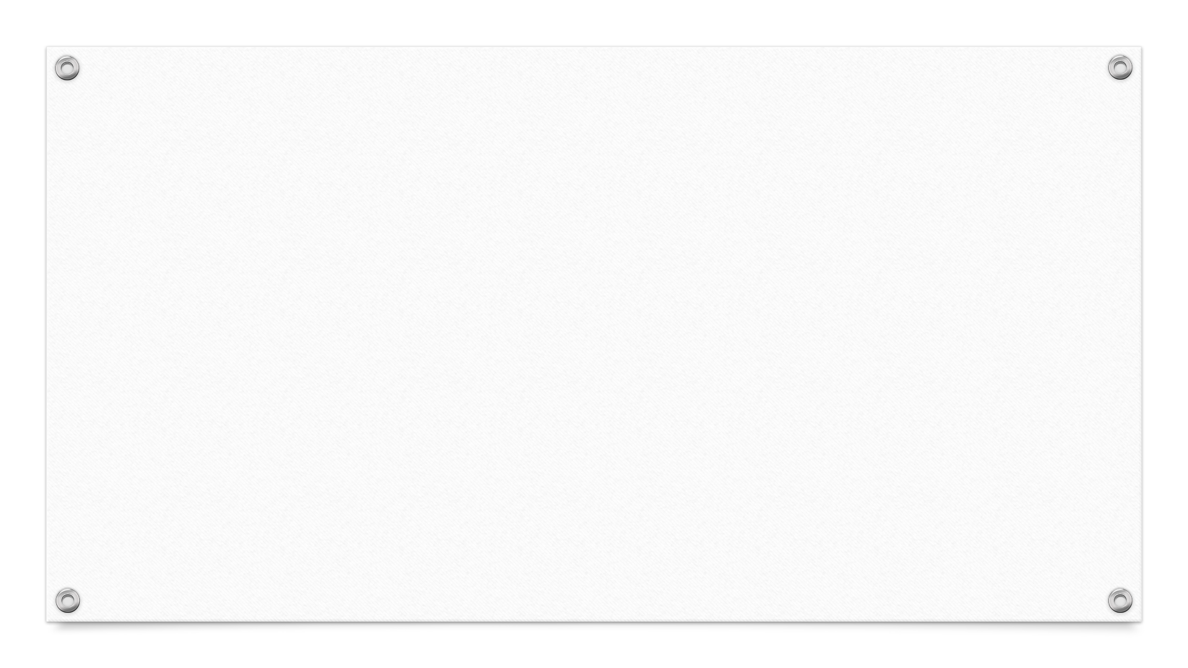

Business Questions
Based on previous sales for the top Publisher could we make a recommendation on what genre they create a game for?

Slide 4
Methodology
Look at the Publisher and Platform performance over time.
Rank the publishers based on total market share.
Rank each genre.
Determine the projection of sales based on genre.

Slide 5
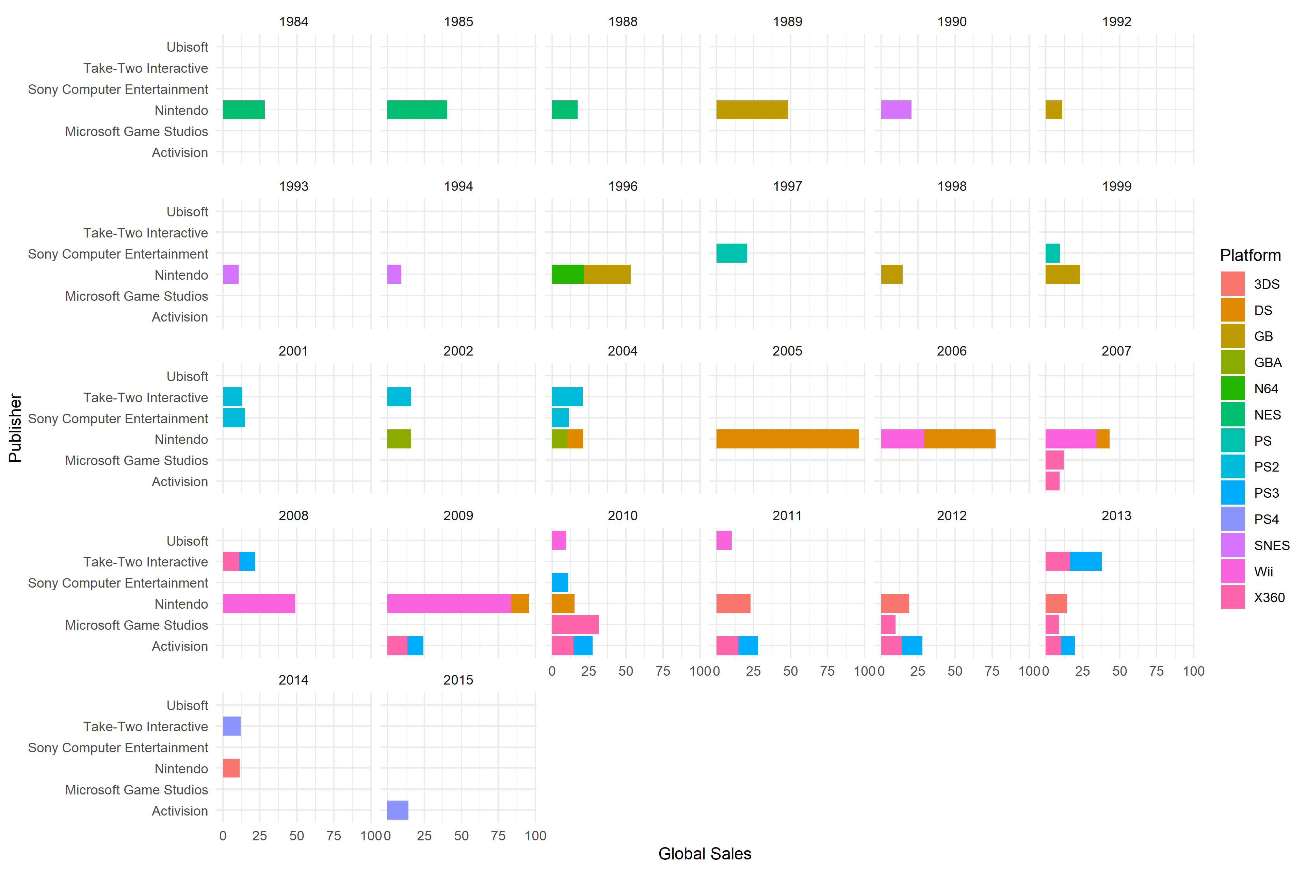

Slide 6
Publisher Sales by Market
In order to determine the top three publishers based on market, four different data frames were merged to create a new data frame called “puballup”.
puballup<-data.frame(pubmerge2.2,pubmerge3.3,pubmerge4.4,pubmerge5.5)
The table below shows the top three publishers based on the four different markets. Nintendo has shown to be the top-ranking Publisher in North America, Europe, and Japan; making it the top seller around the Globe.
Rank | Publisher | Global Sales | Publisher | North America Sales | Publisher | Europe Sales | Publisher | Japan Sales
#1 | Nintendo | 1703.62 | Nintendo | 775.38 | Nintendo | 389.72 | Nintendo | 451.65
#2 | Electronic Arts | 1110.15 | Electronic Arts | 595.07 | Electronic Arts | 371.27 | Namco Bandai Games | 127.07
#3 | Activision | 727.11 | Activision | 429.7 | Activision | 215.53 | Konami Digital Entertainment | 91.3

Slide 7
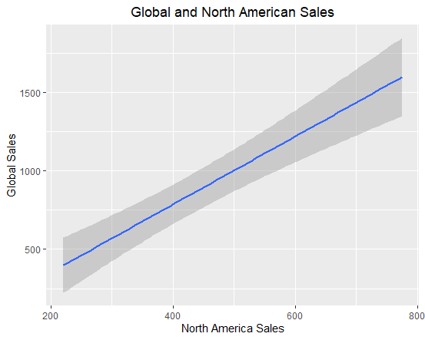
Publisher Sales by Market
Sales by Publisher in North America continue to outweigh all other markets.
In 2017, North American sales accounted for 41.7% of Nintendo’s sales (WePC, 2020).
The greatest predictor in how high Global Sales will climb on any given year based on the publisher, can be best determined by looking to the sales within North America.
Multiple R-Squared: .9599
Adjusted R-Squared: .9498
p-value: 0.0006125
Standard Deviation in North America Sales: 222.93

Slide 8
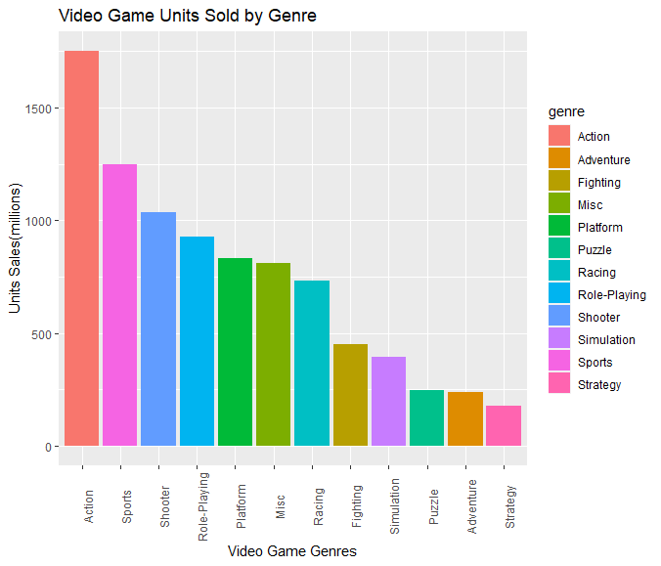
Genre to Target
statsVGstatsVG(genreSalesTotal$naSales) mean: 362.6217 median: 343.35 min: 68.7 max 877.83 sd: 245.5669 quantile(0.05-0.95): 89.105 -- 748.046 statsVG(genreSalesTotal$euSales) mean: 200.4258 median: 194.845 min: 45.34 max 525 sd: 142.7231 quantile(0.05-0.95): 48.332 -- 427.5565 statsVG(genreSalesTotal$jpSales) mean: 200.4258 median: 194.845 min: 45.34 max 525 sd: 142.7231 quantile(0.05-0.95): 48.332 -- 427.5565 statsVG(genreSalesTotal$otherSales) mean: 65.77417 median: 55.6 min: 11.36 max 187.38 sd: 52.66799 quantile(0.05-0.95): 12.0145 -- 153.9015
Based of the genre sales trend Nintendo should target action and sports genre
Nintendo should keep its focus in what they do best which is Role-Playing, Platform and Action Games

Slide 9
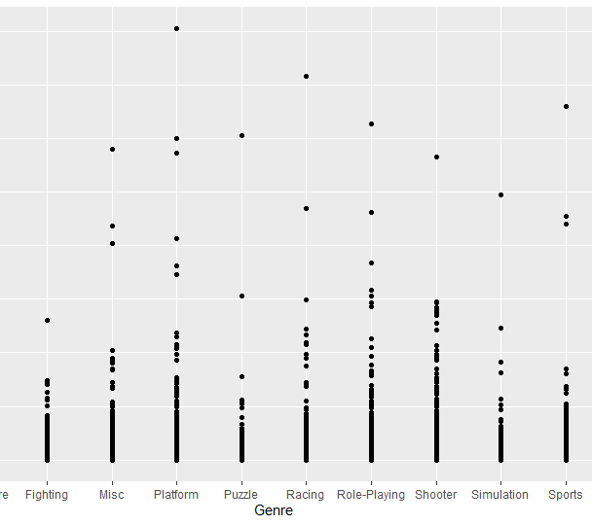
Genre to Target
This graph highlights the breakout games per genres
Using this graph Nintendo should avoid fighting games and simulation games

Slide 10
Outcomes and Recommendations
Outcomes
Video games are currently in the growth stage of the life cycle, making this is an opportune time to enter the market.
​Nintendo is the highest grossing Publisher in all Markets.
​Action is the highest grossing genre in NA and Europe
​Japan is the outlier with role-playing games as their top selling Genre.
Recommendation
Nintendo should seek to enter into these markets based on the markets highest grossing genre

Slide 11
Questions?

